Slide 1
組合最佳化問題 基於既定的限制or給分條件
(Combinatorial Optimization Problems)
Constructive Methods
(search tree for goals)
Iterative Methods
(search plane for optima)
可用傳統方法拓展樹形
穩紮穩打, 謀定而後動
也可用鄰近解漸近搜尋
以戰養戰, 先求有再求好
Advanced Search

Slide 2
What is Artificial Intelligence?
Recall:
A more difficult question is: What is intelligence?
This question has puzzled philosophers, biologists and psychologists for centuries.
Artificial Intelligence is easier to define, although there is no standard, accepted definition.
星艦戰將與
蝸蟲的學習
學習與創作是否是另一種形式的搜尋?
記憶
評判
搜尋解答
邏輯推理
控制
學習
創作

Slide 3
Outline
Recall:
Problem Solving
Data-Driven (forward-chaining)
Goal-Driven (back-chaining)
e.g.
Brute-Force Search (exhaustive Search)
Beam Search
Maze, Proof
Blind Search (Generate & Test)
Heuristic Search (Informed Method)
DFS
BFS
Iterative Deepening Search
Hill Climbing
Best-first S.
A* family
A* Alg.
British Museum Procedure
(identifying the optimal path)
Uniform Cost Search
(Branch and Bound, Dijkstra)
Not always complete
Evaluation function
Greedy Search

Slide 4
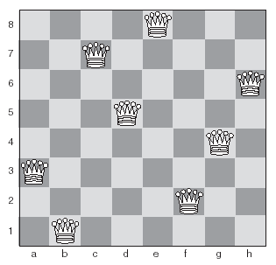
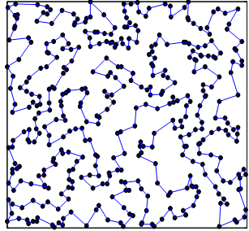
Examples
Eight-Queens
TSP (instance/rd400)

Slide 5
Contents
-- The eight queens problem
-- Traveling Salesman problem
Constraint satisfaction problems
Combinatorial optimization problems (problem)
Heuristic repair (example)
Local search and Meta-heuristics (method)
  Exchanging heuristics
  Iterated local search
  (Ant Colony Optimization)
  Taboo Search
  Simulated annealing
  Genetic algorithms
Constructive Methods
(search tree for goals)
Iterative Methods
(search plane for optima)

Slide 6
Search Methods
Constructive Methods
(search tree for goals)
由這兩個例子
來看這些 methods
Search for Goals
(8-Queens/conflict=0)
Search for Optima
(TSP/ lowest cost)
Constraint Satisfaction
forward checking (Dead Ends?)
DFS (64 x 63 x…)
8!
DFS (n x (n-1) x…)
∞
Heuristic (which branch first?)
Most-Constrained Variables
A* Algorithm
Local Search (metaheuristics)
Heuristic Repair
k-opt exchanging
search space
General Metaheuristics
  Exchanging heuristics
  Iterated local search
  (Ant Colony Optimization)
  Taboo Search
  Simulated annealing
  Genetic algorithms
search tree
search plane =
untraceable branches
Iterative Methods
(search plane for optima)

Slide 7
TSP using A*
 | A | B | C | D | E
A |  | 4 | 8 | 9 | 5
B | 4 |  | 3 | 5 | 1
C | 8 | 3 |  | 6 | 7
D | 9 | 5 | 6 |  | 2
E | 5 | 1 | 7 | 2
h(B^{A})=min(B-CDE)+
min(CDE-A)+
min(C-D,D-E,E-C)|₂
=1+5+(2+6)=14
A
4
5
8
9
B^{A}
C^{A}
D^{A}
E^{A}
h(C^{BA})=min(C-DE)+
min(DE-A)+
min(D-E)|₁
=6+5+(2)=13
4+14
8+10
9+10
5+13
3
5
1
C^{BA}
D^{BA}
E^{BA}
State: D^{A}="A-D", D^{BA}="A-B-D"
7+13
A

Slide 8
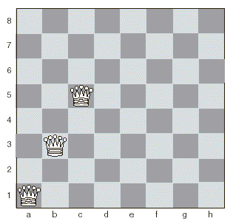
Most Constrained Variables
d → 3
e → 3
f → 1
g → 3
h → 4
Forward checking:
63(or 62…) 個選擇中只選次一排
並 -1 (or -2…) 個位置
MCV:
兼可跳排

Slide 9
Search Methods
or
Dead end 提早發現
Constructive Methods
(search tree for goals)
Beam Search
Beam Search + heuristics : #(group)
由這兩個例子
來看這些 methods
Search for Goals
(8-Queens/conflict=0)
Search for Optima
(TSP/ lowest cost)
Constraint Satisfaction
forward checking (Dead Ends?)
DFS (64 x 63 x…)
8!
DFS (n x (n-1) x…)
∞
Heuristic (which branch first?)
Most-Constrained Variables
A* Algorithm
Local Search (metaheuristics)
Heuristic Repair
k-opt exchanging
search space
General Metaheuristics
  Exchanging heuristics
  Iterated local search
  (Ant Colony Optimization)
  Taboo Search
  Simulated annealing
  Genetic algorithms
search tree
search plane =
untraceable branches
Iterative Methods
(search plane for optima)

Slide 10
Constraint Satisfaction Problems
A constraint satisfaction problem is a combinatorial optimization problem with a set of constraints.
Combinatorial optimization problems involve assigning values to a number of variables.
Can be solved using search.
With many variables it is essential to use heuristics.

Slide 11
The Eight Queens Problem
A constraint satisfaction problem:
  Place eight queens on a chess board so that no two queens are on the same row, column or diagonal.
Can be solved by search, but the search tree is large.
Heuristic repair is very efficient at solving this problem.

Slide 12
Heuristic Repair
A heuristic method for solving constraint satisfaction problems.
Generate a possible solution, and then make small changes to bring it closer to satisfying constraints.

Slide 13
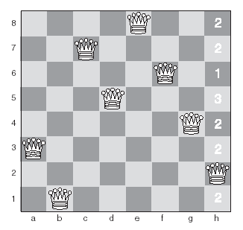
Heuristic Repair for The Eight Queens Problem
Initial state – one queen is conflicting with another.
We’ll now move that queen to the square with the fewest conflicts.

Slide 14
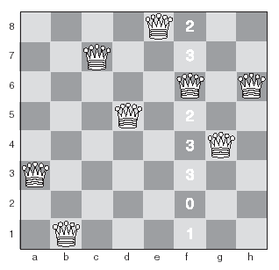
Heuristic Repair for The Eight Queens Problem
Second state – now the queen on the f column is conflicting, so we’ll move it to the square with fewest conflicts.

Slide 15
Heuristic Repair for The Eight Queens Problem
Final state – a solution!

Slide 16
break

Slide 17
Search Methods
Recall:
Constructive Methods
(search tree for goals)
由這兩個例子
來看這些 methods
Search for Goals
(8-Queens/conflict=0)
Search for Optima
(TSP/ lowest cost)
Constraint Satisfaction
forward checking (Dead Ends?)
DFS (64 x 63 x…)
DFS (n x (n-1) x…)
Heuristic (which branch first?)
Most-Constrained Variables
A* Algorithm
Local Search (metaheuristics)
Heuristic Repair
k-opt exchanging
search space
General Metaheuristics
  Exchanging heuristics
  Iterated local search
  (Ant Colony Optimization)
  Taboo Search
  Simulated annealing
  Genetic algorithms
search tree
search plane =
untraceable branches
Iterative Methods
(search plane for optima)

Slide 18
Local Search
Like heuristic repair, local search methods start from a random state, and make small changes until a goal state is achieved.
Local search methods are known as metaheuristics.
Most local search methods are susceptible to local maxima, like hill-climbing.

Slide 19
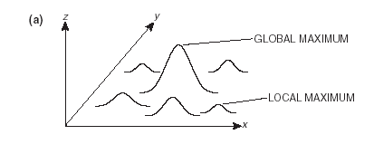
Foothills
3 issues
  A foothill is a local maximum.
8-queens
TSP
E(w₁,w₂)
主翼長w₁、尾翼寛w₂
投射{X}₁₀₀與落點{Y}₁₀₀要求

Slide 20
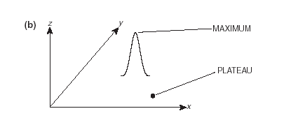
Plateaus
3 issues
沒有方向可走
要看遠一點
  Cause difficulties for hill-climbing methods.
  Flat areas that make it hard to find where to go next.

Slide 21
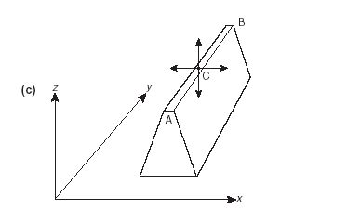
Ridges
3 issues
有方向可走
但是窄到看不到
要看廣一點
  Cause difficulties for hill-climbing methods
  B is higher than A.
  At C, the hill-climber can’t find a higher point North, South, East or West, so it stops.

Slide 22
Exchanging Heuristics
A simple local search method.
Heuristic repair is an example of an exchanging heuristic.
Involves swapping two or more variables at each step until a solution is found.
A k-exchange involves swapping the values of k variables.
Can be used to solve the traveling salesman problem.

Slide 23
Iterated Local Search
A local search is applied repeatedly from different starting states.
Attempts to avoid finding local maxima.
Useful in cases where the search space is extremely large, and exhaustive search will not be possible.

Slide 24
Taboo Search (Tabu Search)
  避開禁忌區域
  TSP – 某些 2-opt 會收歛過去的臨近狀態
  (w₁, w₂) – 某些臨近值
Ant Colony Optimization
  Artificial Life
  TSP – 越快走一遍的軌跡越密 (要符合TSP限制)

Slide 25
Simulated Annealing
A method based on the way in which metal is heated and then cooled very slowly in order to make it extremely strong.
Based on metropolis Monte Carlo Simulation.
Aims at obtaining a minimum value for some function of a large number of variables.
  This value is known as the energy of the system.
TSP: 先大亂掉，再小亂，最後收斂

Slide 26
Genetic Algorithms
A method based on biological evolution.
Create chromosomes which represent possible solutions to a problem.
The best chromosomes in each generation are bred with each other to produce a new generation.
Much more detail on this later.
詳附錄

Slide 27
break

